Slide 1
Think Innovation
Week 2023
Anaëlle Hily
Fabio Cruz
Prototyping your Ideas
ENSGSI / ERPI / LF2L

Slide 2
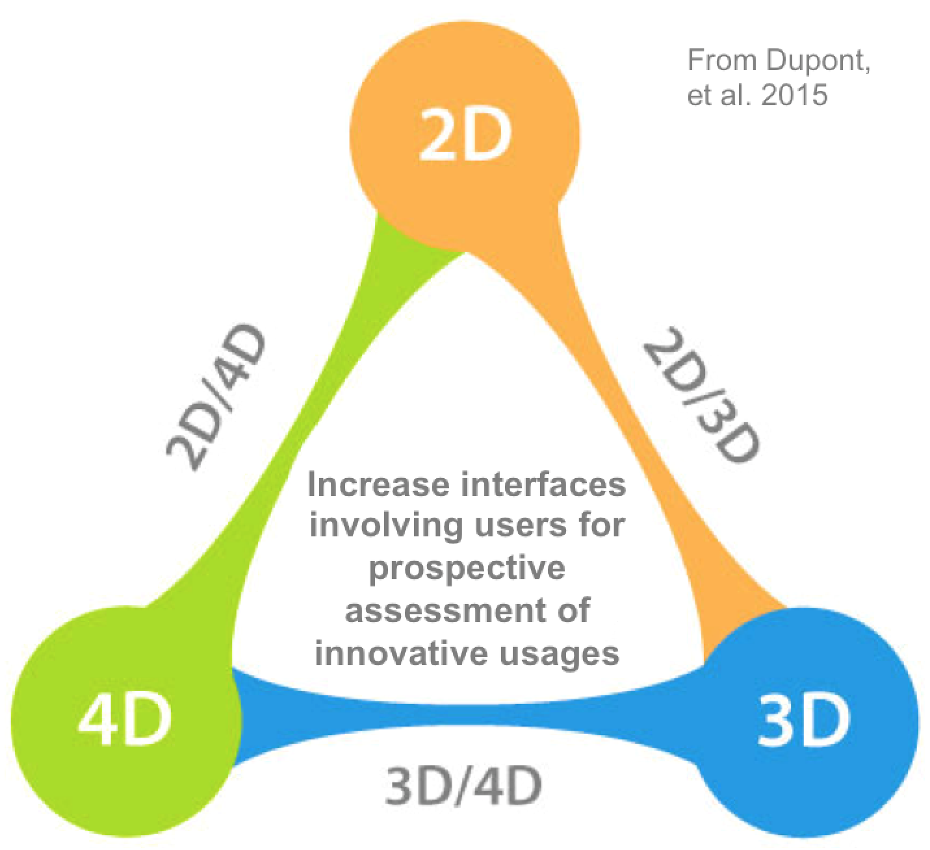
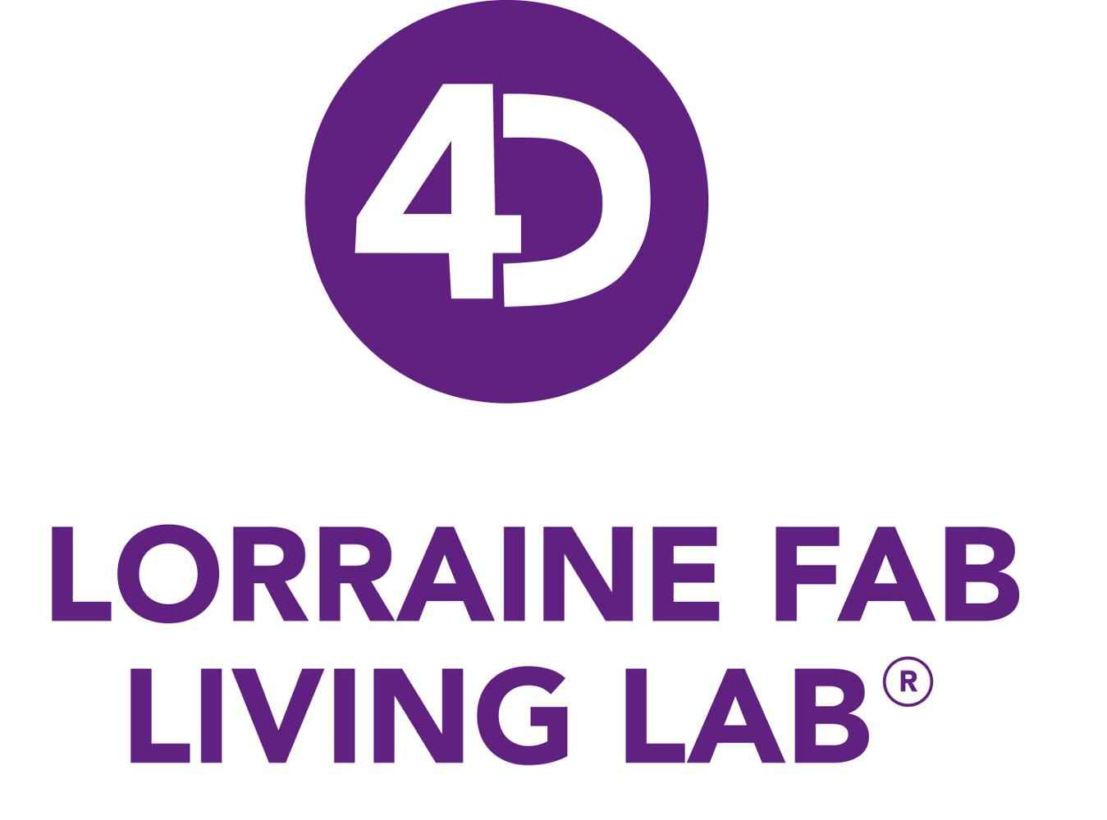
Research platform for prospective assessment of innovative usages

Slide 3
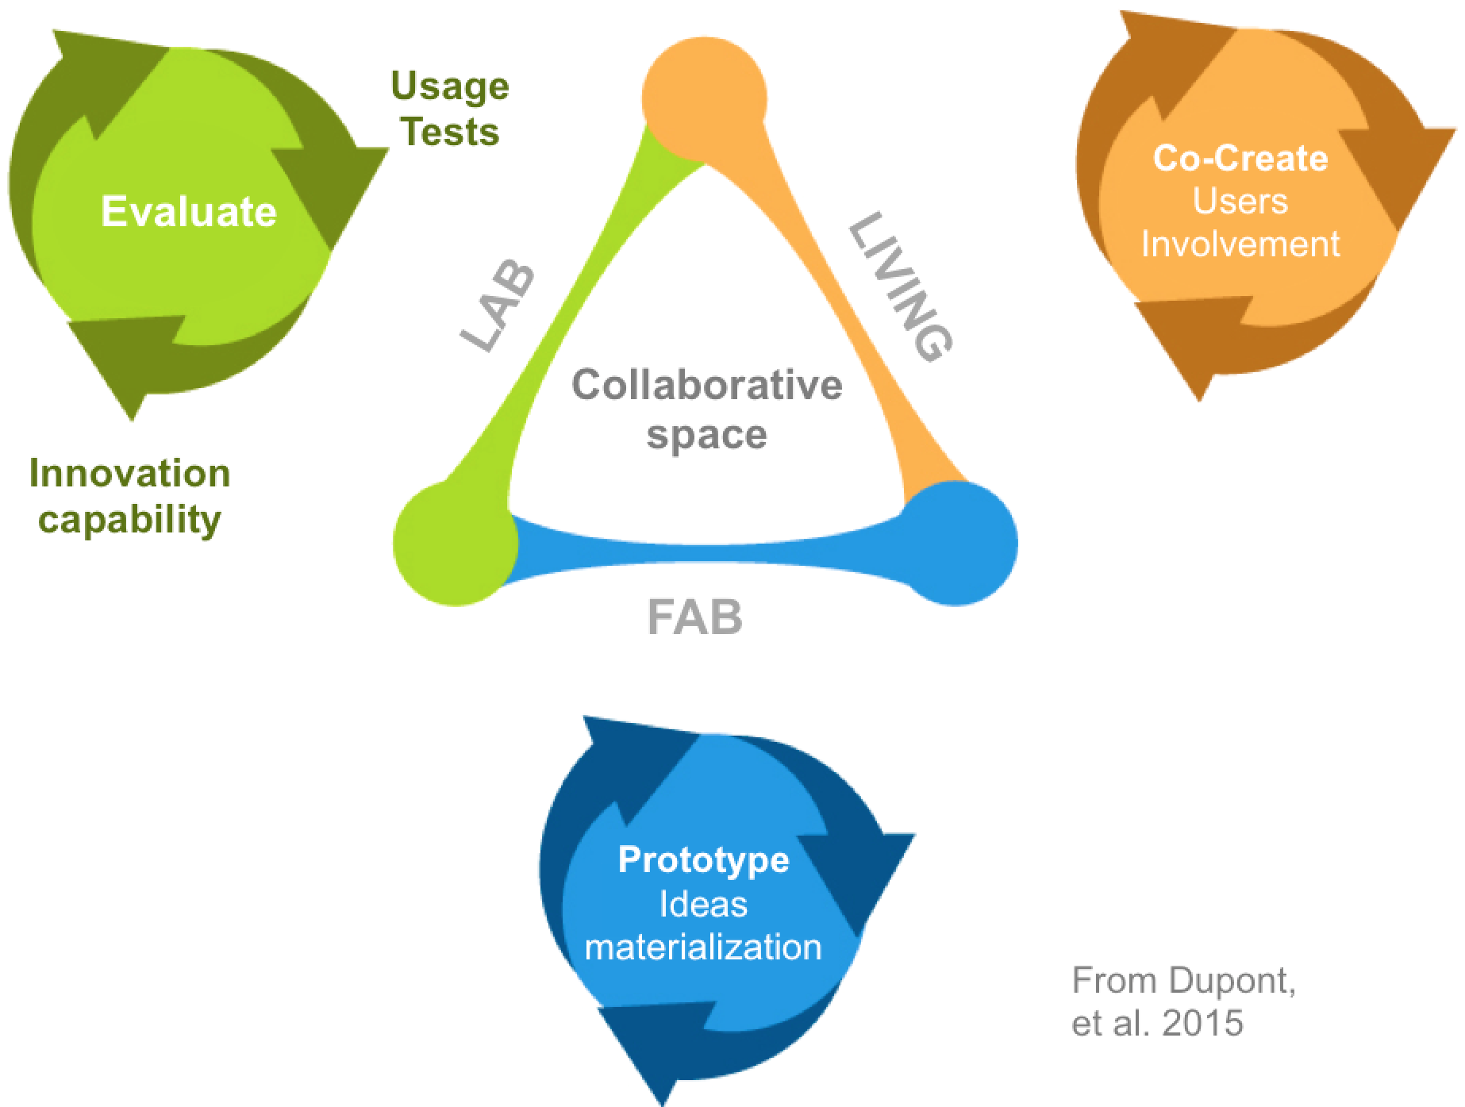
Complementary dynamics and technologies
Accelerate demonstrator's deployment for
Companies
Sectors
Cities and territories

Slide 4
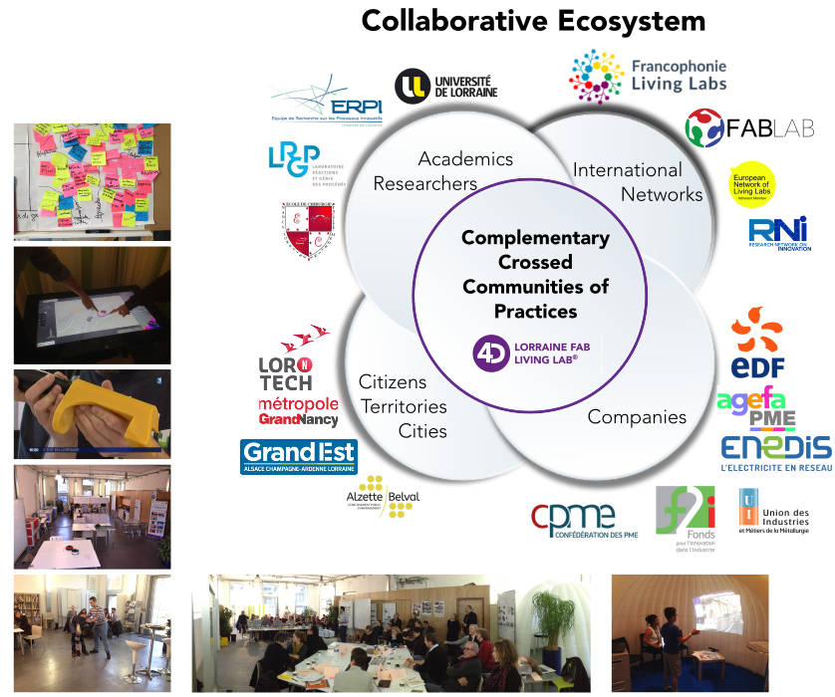
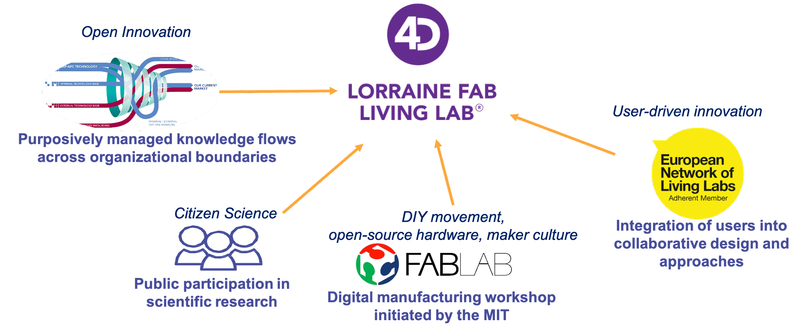
Materialize Citizen Innovation

Slide 5
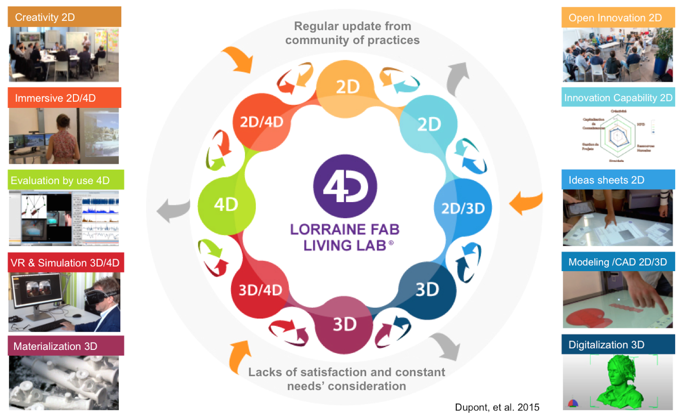

Slide 6
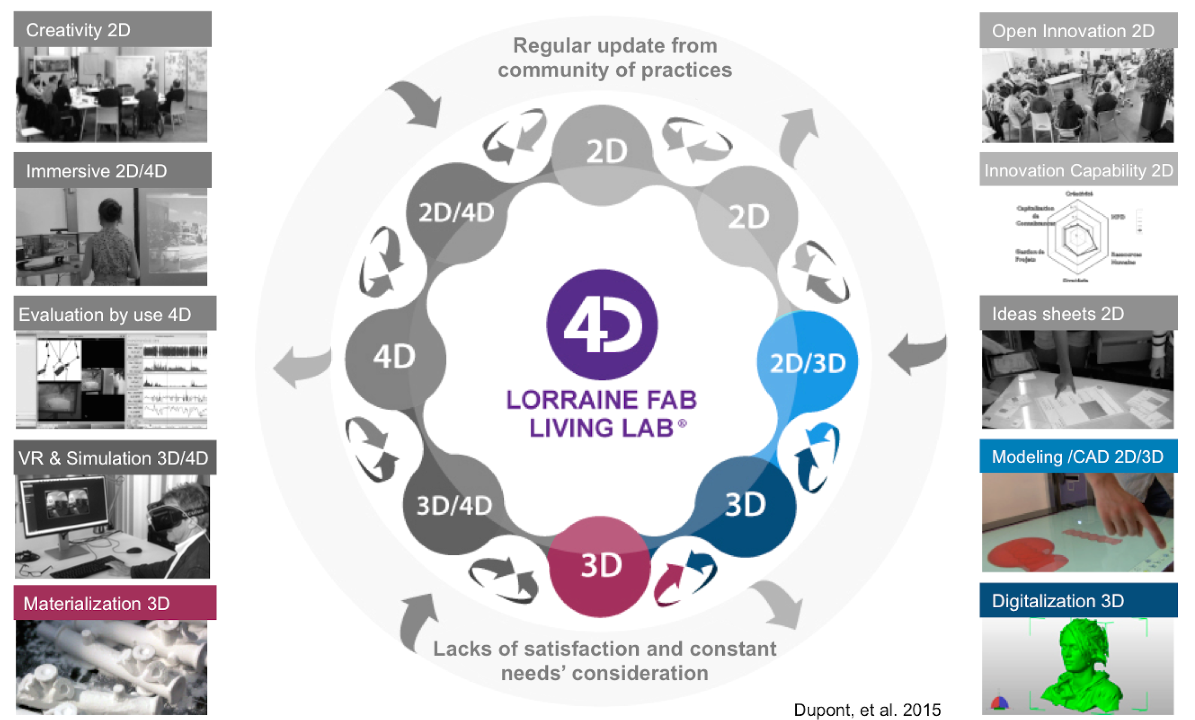

Slide 7
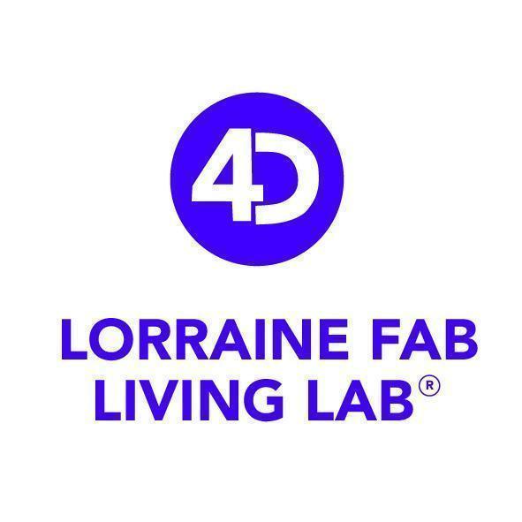
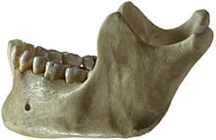
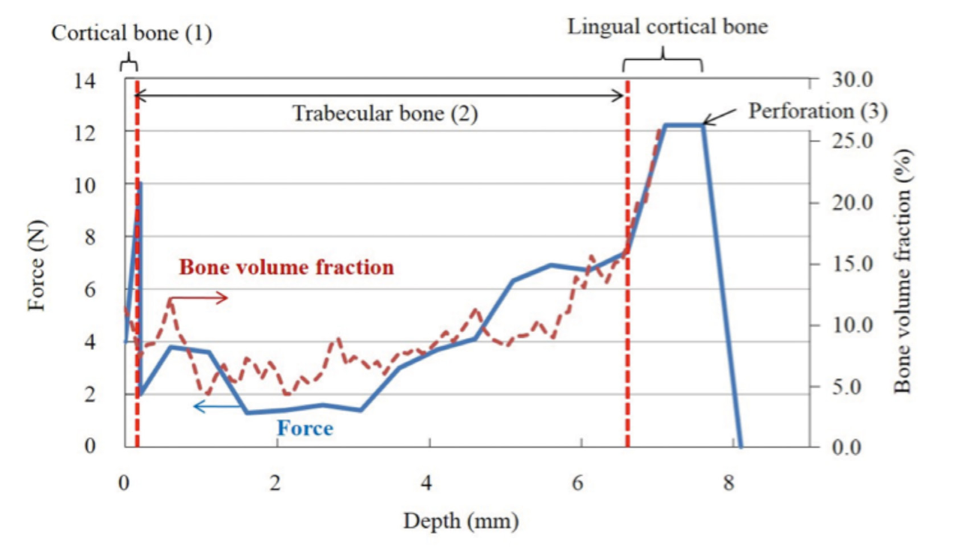
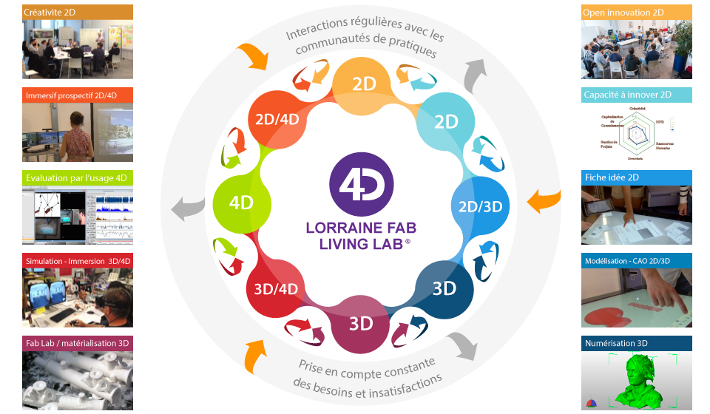
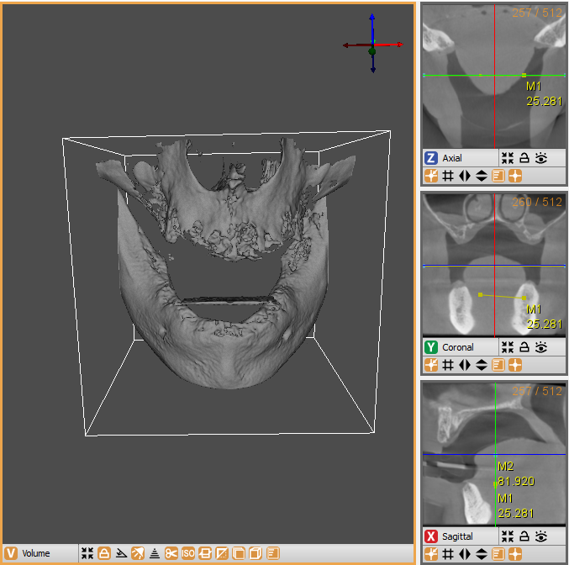
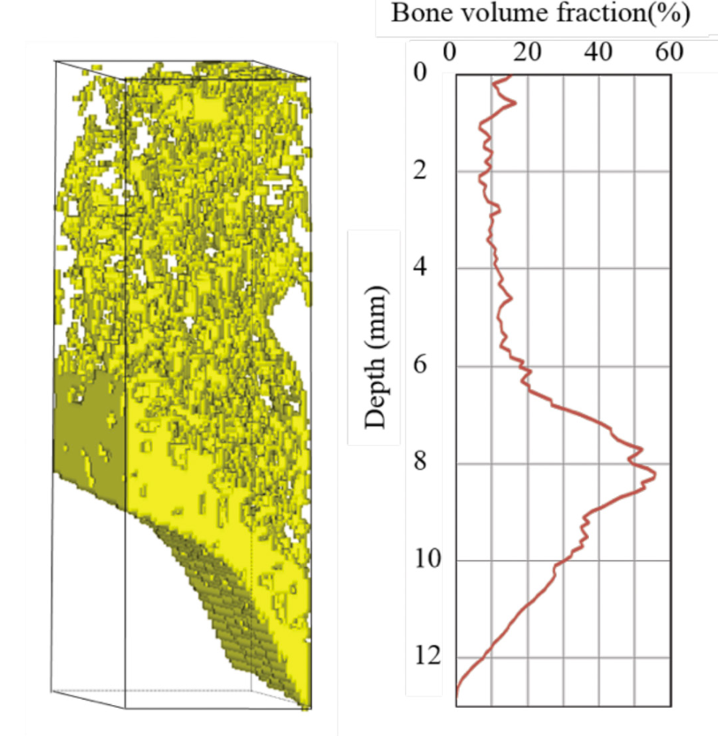
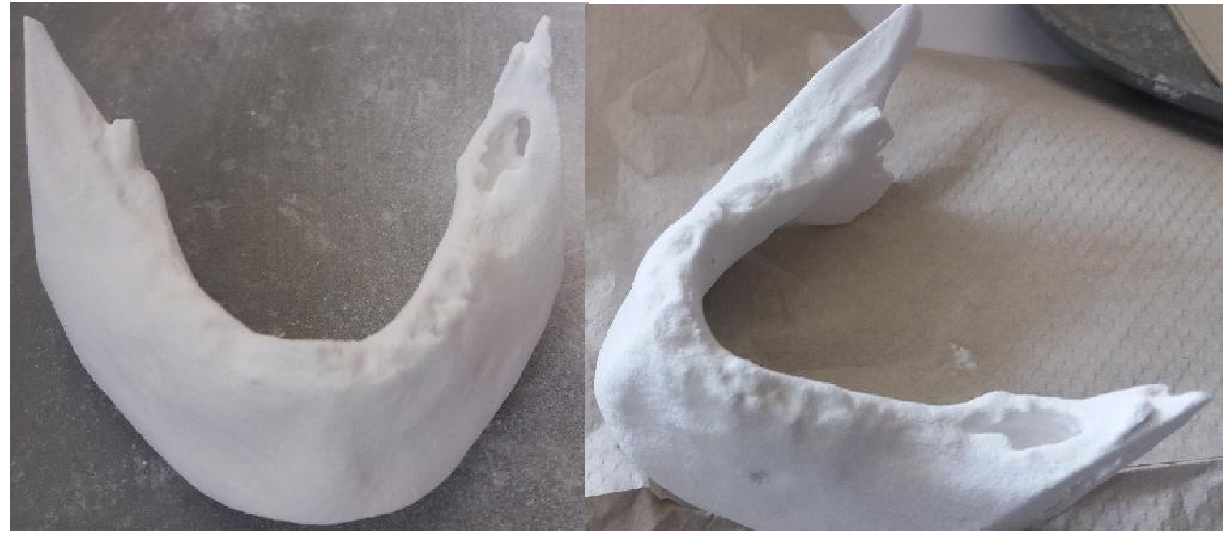
Cas pratique : modèles d’entrainement dentaires
Pilote : G. Arbelaez / Mise en œuvre : LF2L + A Hily + M2 IDEAS
Période : 2018
Créativité 2D
Open Innovation 2D
Evaluation par l’usage 4D
Fiches idées 2D
Numérisation 3D
Matérialisation 3D

Slide 8
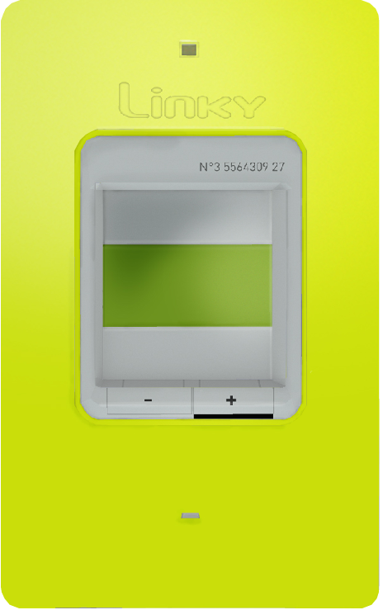
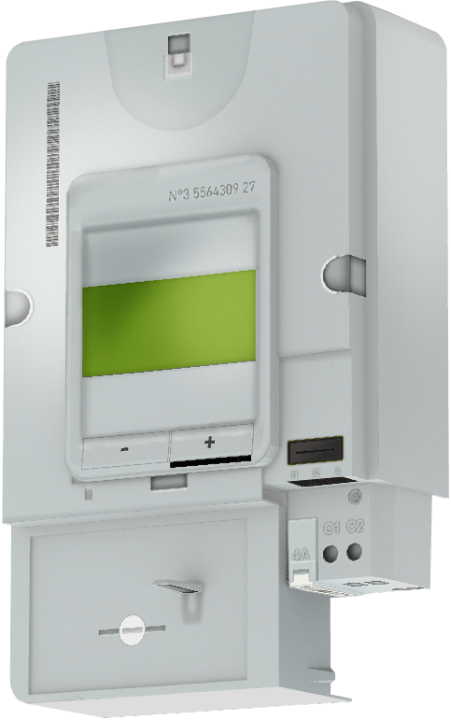
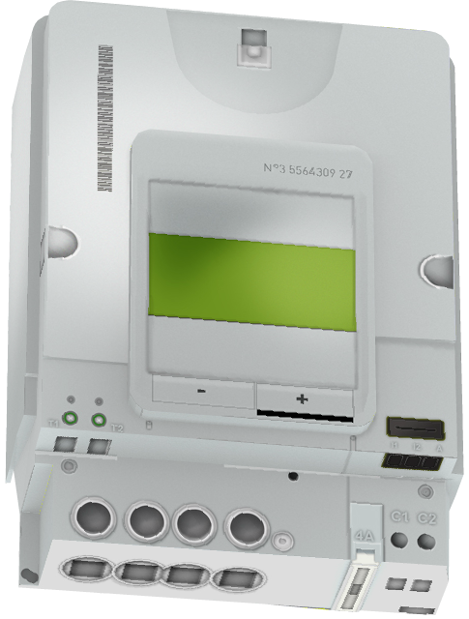
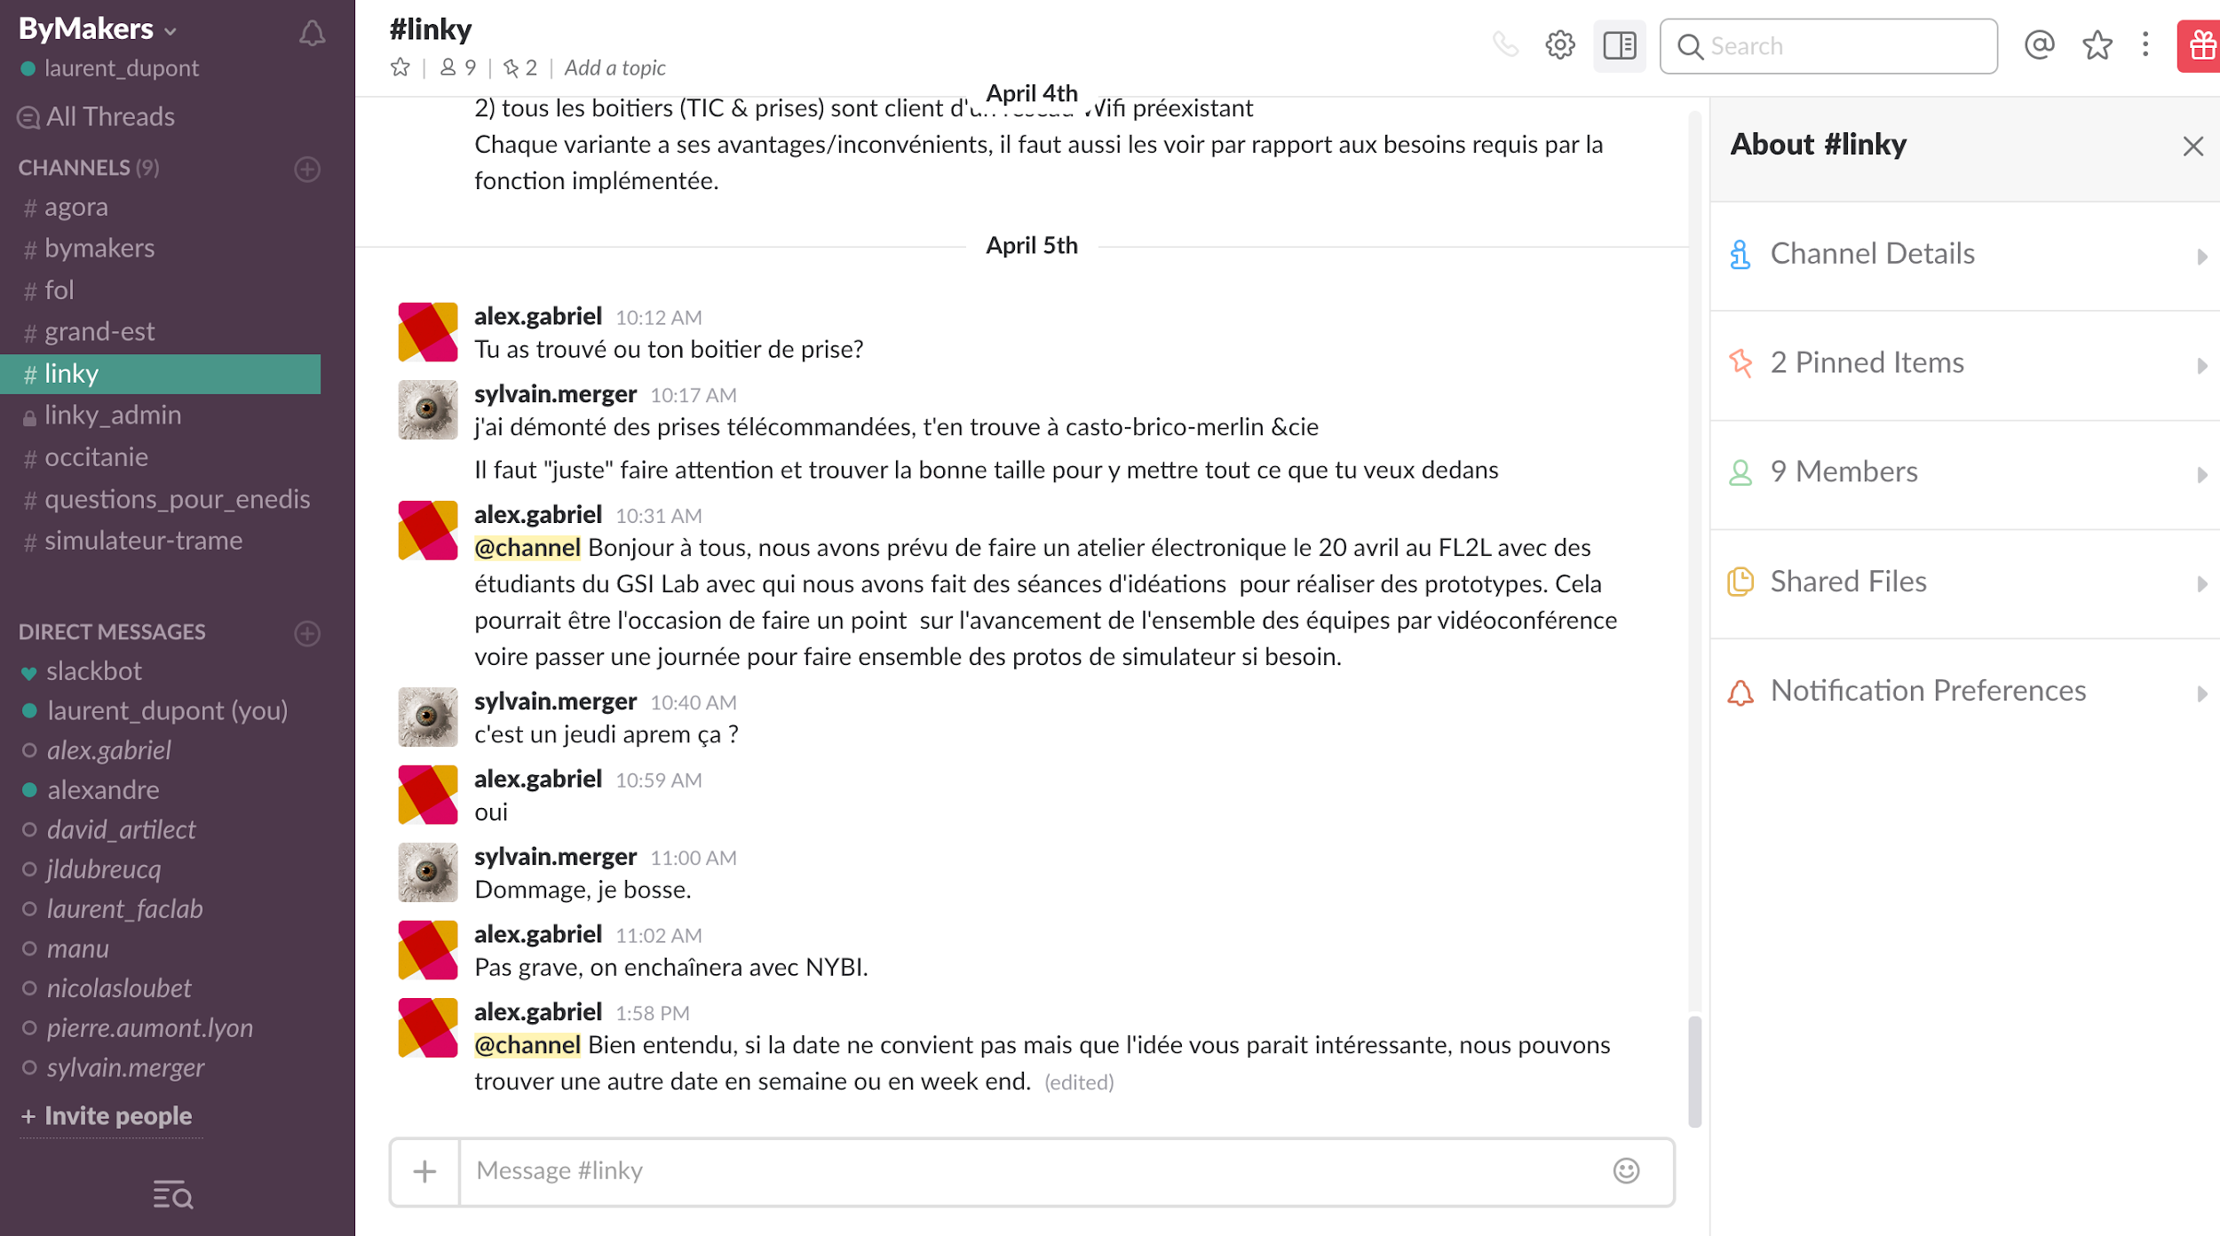

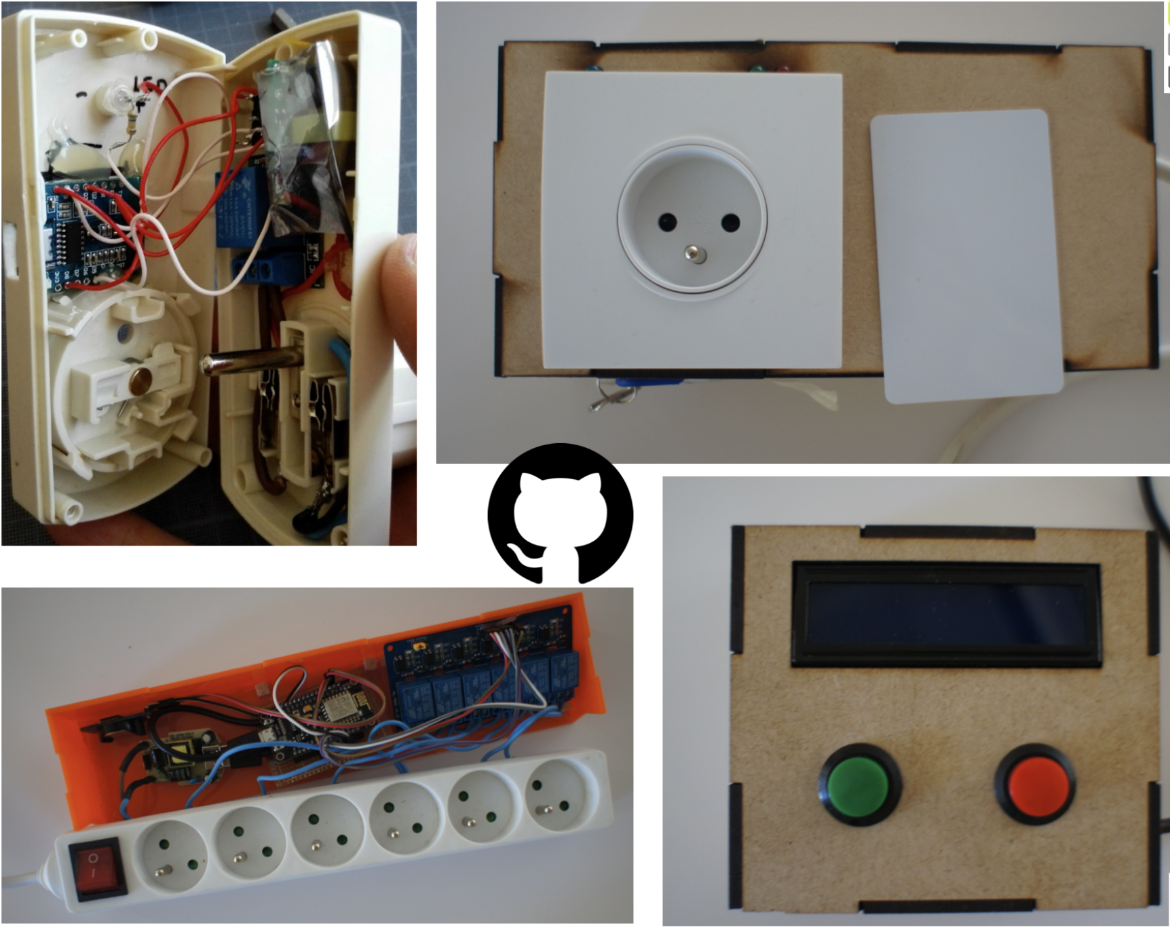
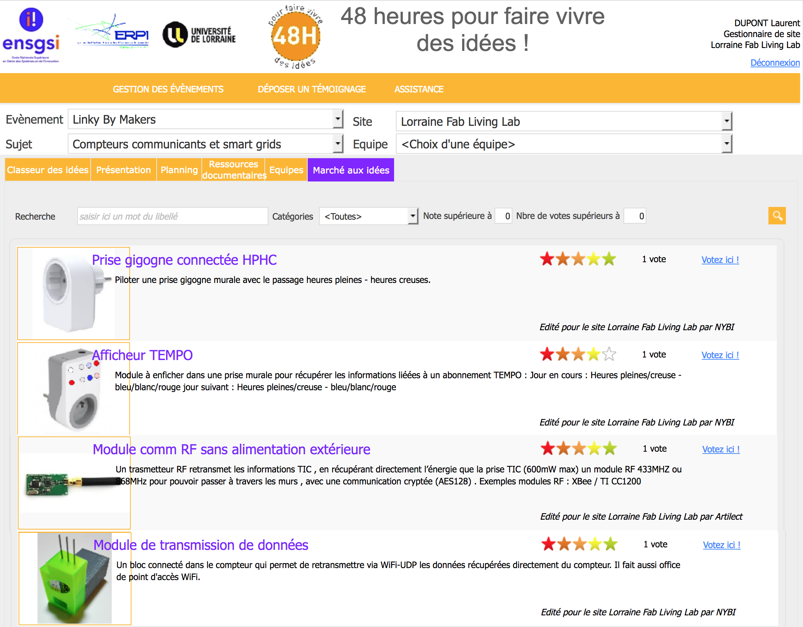
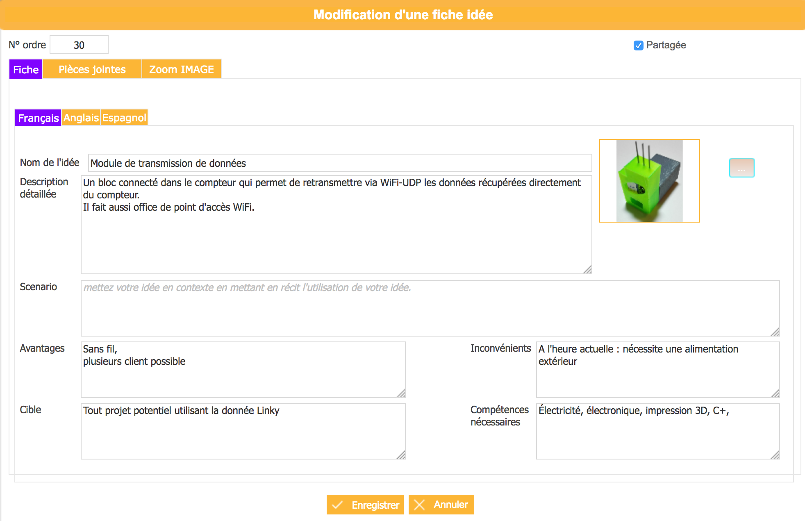
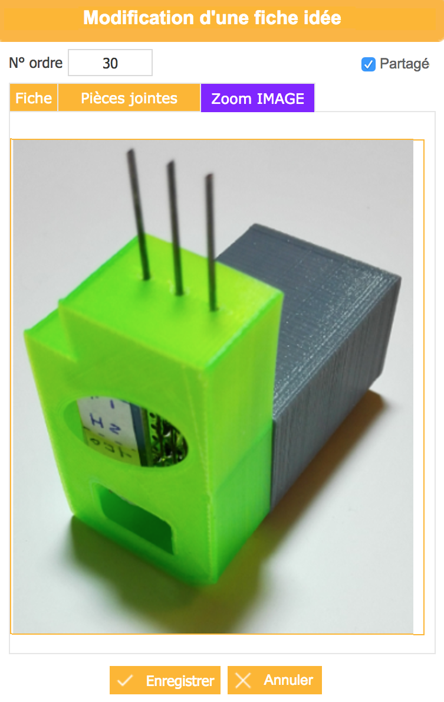
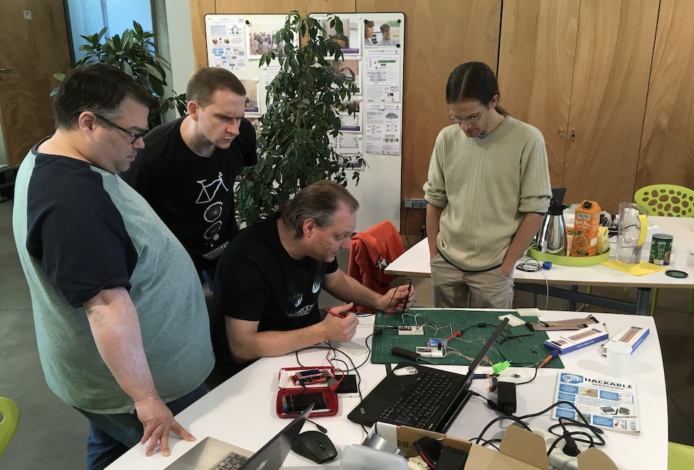
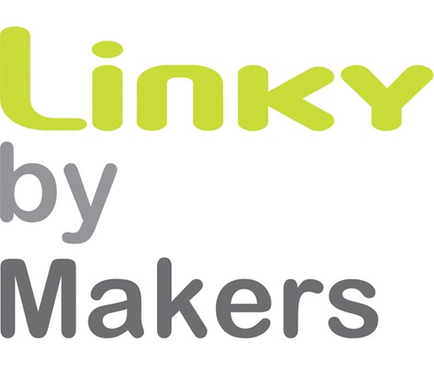
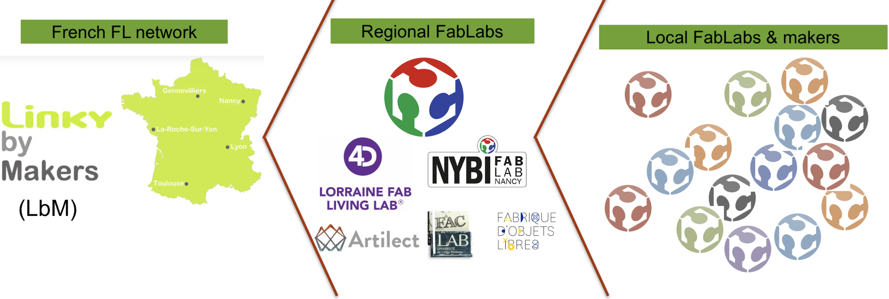
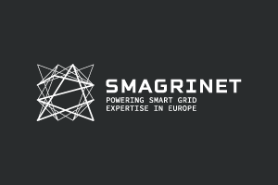


Linky by Makers
Open Innovation 2D
Pilote : L. Dupont / Mise en œuvre : LF2L + RFFL
Période : 2015-2017
Evaluation par l’usage 4D
Open Source hardware production available at: https://github.com/LF2L
Créativité 2D
Fiches idées 2D
Matérialisation 3D
Modélisation 2D/3D
Notes:
Laurent Dupont, Alex Gabriel, Mauricio Camargo, Claudine Guidat. Collaborative Innovation Projects Engaging open communities: a Case Study on Emerging Challenges. 23rd ICE/IEEE International Conference on Technology, Management and Innovation, Jun 2017, Madeira Island, Portugal. 〈10.1109/ICE.2017.8280002〉. 〈hal-01582548〉: https://hal.univ-lorraine.fr/hal-01582548v1
Dupont L., Mastelic J., Nyffeler N., Latrille S., Seulliet E.. Living lab as a support to trust for co-creation of value: application to the consumer energy market. Journal of Innovation Economics & Management, De Boeck Supérieur 2019, 28 (1), pp.53-78. 〈https://www.cairn.info/revue-journal-of-innovation-economics-2019-1-page-53.htm〉. 〈10.3917/jie.028.0053〉. 〈hal-02010217〉
Dupont L., Mastelic J., Nyffeler N., Latrille S., Seulliet E. Confiance et Technologie : Deux Dimensions de l’Innovation Ouverte et Agile appliquée à l’Énergie. Technologie et innovation, ISTE OpenScience, 2019, 4 (1), 〈10.21494/ISTE.OP.2019.0314〉. 〈hal-02047441〉
see also this page
+ 10 concepts de protype sur GitHub
+ Rapport exaustif à ENEDIS
+ un projet européen

Slide 9
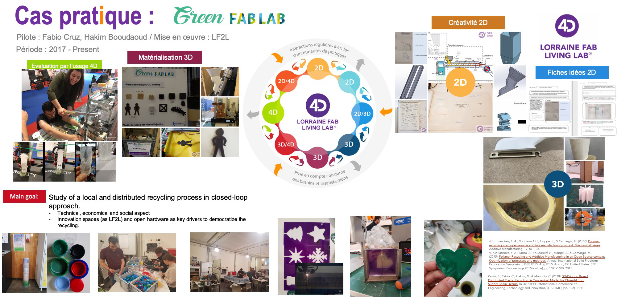

Slide 10




1
2
3
4
Why prototyping matters? .
How to do it?
Prototyping your Idea !
Conclusion of the Day
Agenda

Slide 11
Why prototyping matters?

Slide 12
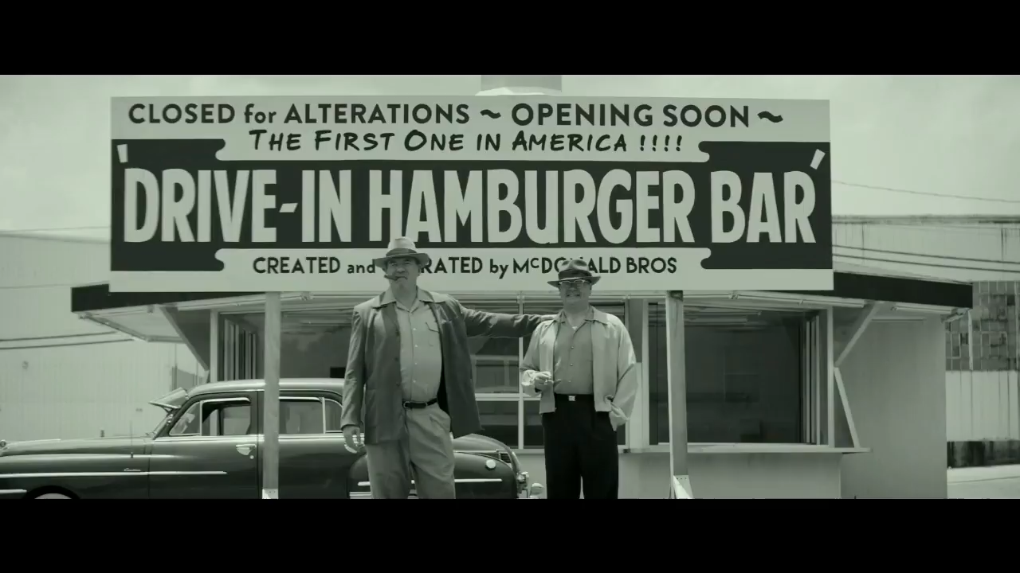
Source: Film The founder

Slide 13


Slide 14
Why Prototyping Matters ?
“Humans are really interesting. If you show them your idea in a prototype form, very few people will tell you what’s right about it.
But everybody will tell you what’s wrong with it.”
David Kelly, IDEO

Slide 15
What is Prototyping ?
“The process of creating usable artifacts at a variety of fidelities of completion, in order to answer design questions and communicate design ideas; with users in the context of use.”

Slide 16
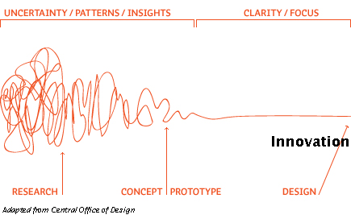
What is Prototyping ?
“The process of creating usable artifacts at a variety of fidelities of completion, in order to answer design questions and communicate design ideas; with users in the context of use.”

Slide 17

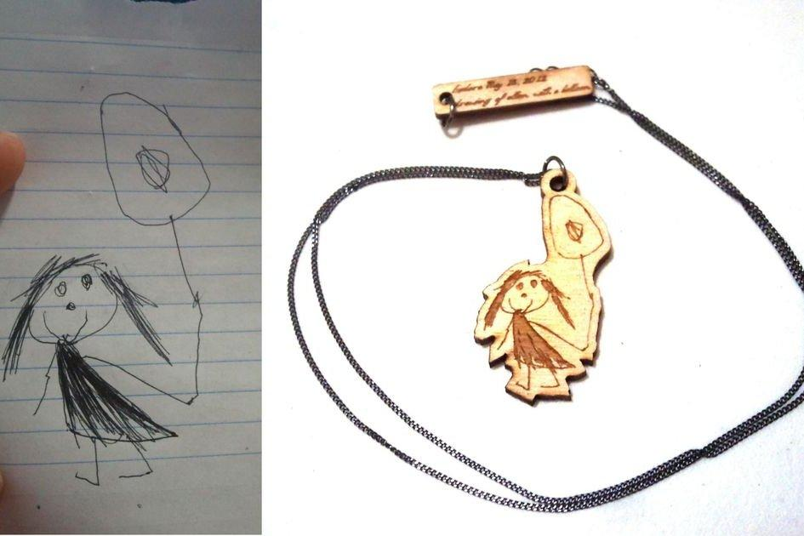
What is Prototyping ?
“The process of creating usable artifacts at a variety of fidelities of completion, in order to answer design questions and communicate design ideas; with users in the context of use.”

Slide 18
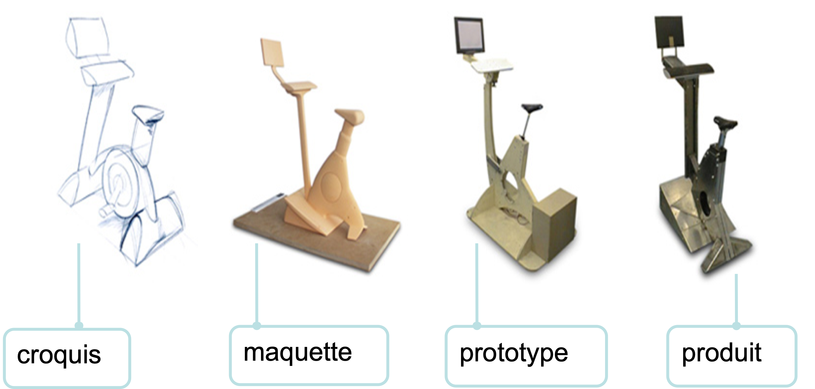
What is Prototyping ?
“The process of creating usable artifacts at a variety of fidelities of completion, in order to answer design questions and communicate design ideas; with users in the context of use.”
Source : (Star & Griesemer, 1989) Illustration : (Kattan, 2009)

Slide 19
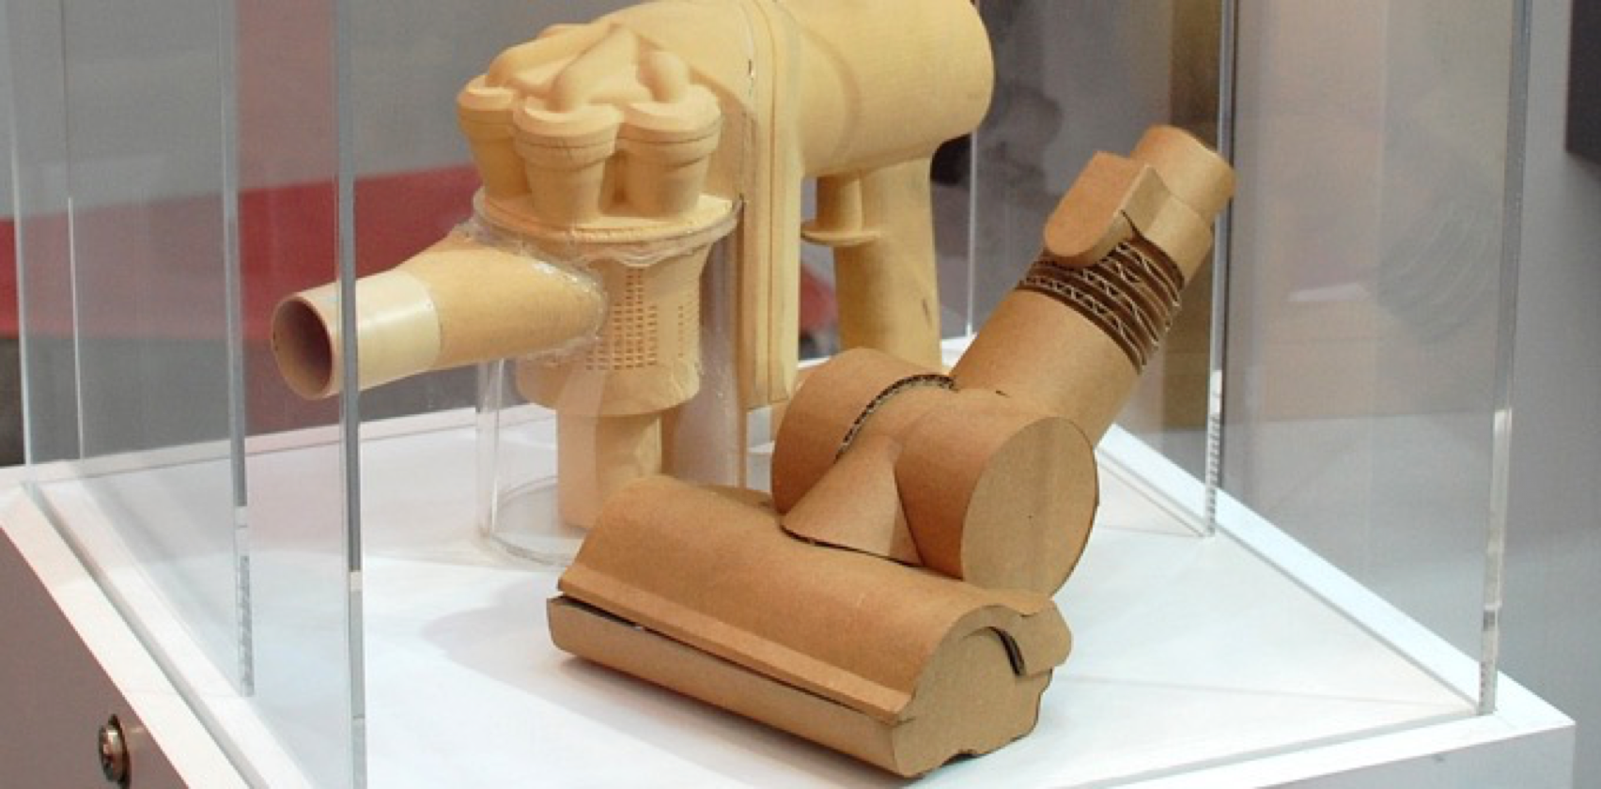
What is Prototyping ?
“The process of creating usable artifacts at a variety of fidelities of completion, in order to answer design questions and communicate design ideas; with users in the context of use.”
Representation
Precision
Interactivity
Evolution
Dyson

Slide 20
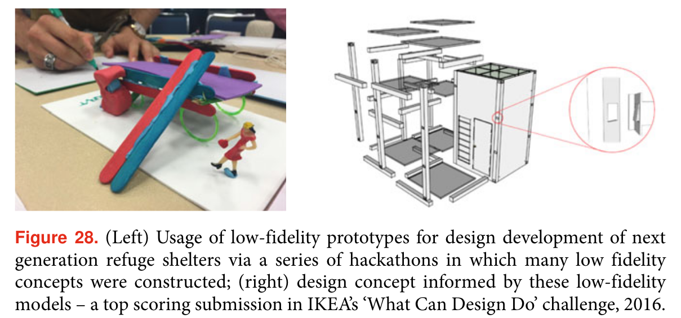
What is Prototyping ?
“The process of creating usable artifacts at a variety of fidelities of completion, in order to answer design questions and communicate design ideas; with users in the context of use.”
Camburn, B., Viswanathan, V., Linsey, J., Anderson, D., Jensen, D., Crawford, R., Otto, K., Wood, K., 2017. Design prototyping methods: state of the art in strategies, techniques, and guidelines. Des. Sci. 3, e13. https://doi.org/10.1017/dsj.2017.10

Slide 21
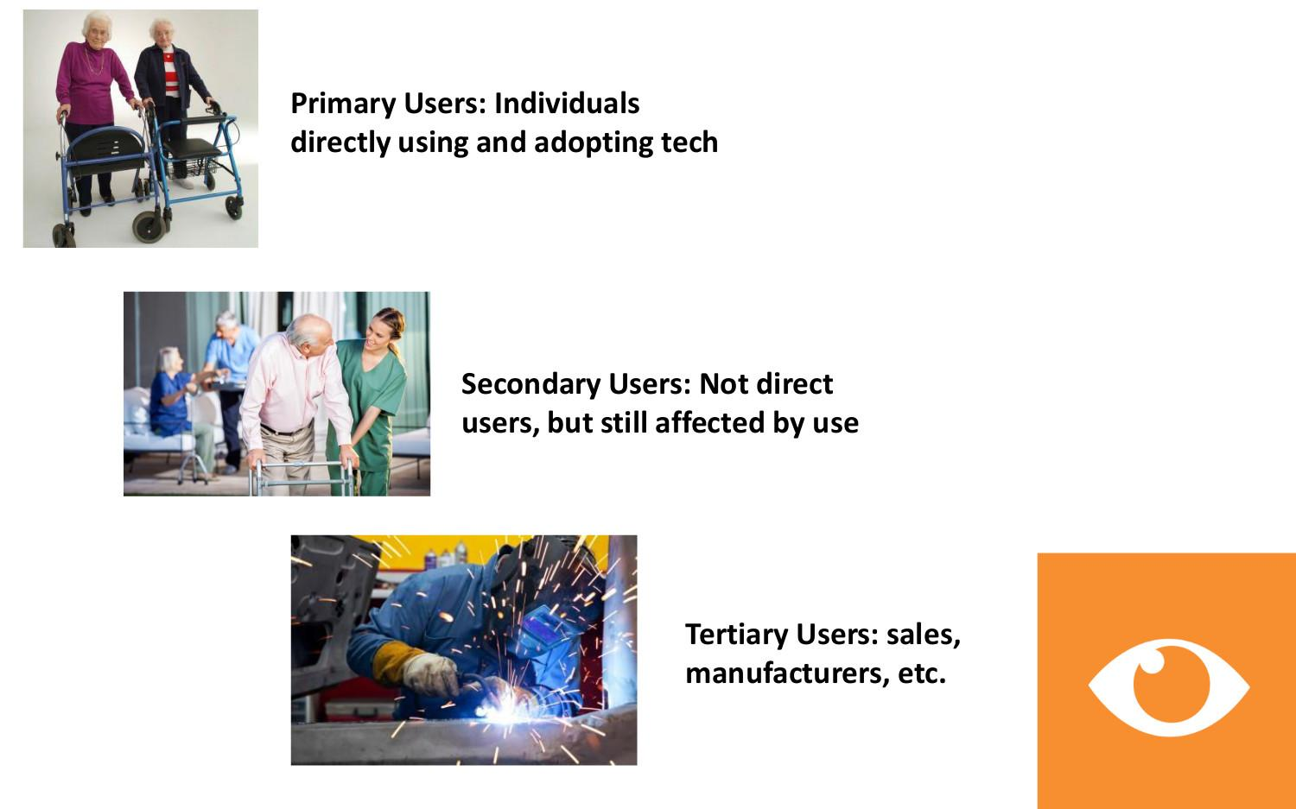
What is Prototyping ?
“The process of creating usable artifacts at a variety of fidelities of completion, in order to answer design questions and communicate design ideas; with users in the context of use.”

Slide 22
What is a Prototype ?
“We define a prototype as a concrete representation of part or all of an interactive system. A prototype is a tangible artifact, not an abstract description that requires interpretation. Designers, as well as managers, developers, customers and end users, can use these artifacts to envision and reflect upon the final system.”

Slide 23
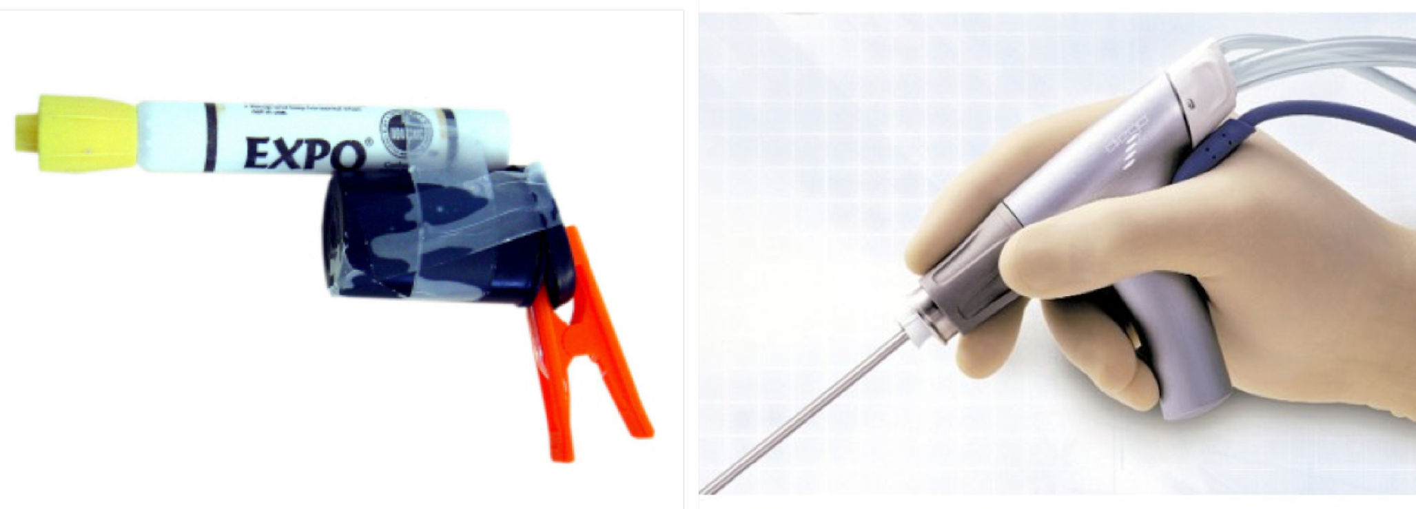
Shared language
Why Prototyping Matters ?
IDO – (OIC) Intermediary design object
“If a picture is worth a thousand words, a prototype [IDO] is worth a thousand meetings.” —Dennis Boyle (IDEO)

Slide 24
Level of details
Why Prototyping Matters ?
IDO – (OIC) Intermediary design object
Source : (Star & Griesemer, 1989) Illustration : (Kattan, 2009)

Slide 25
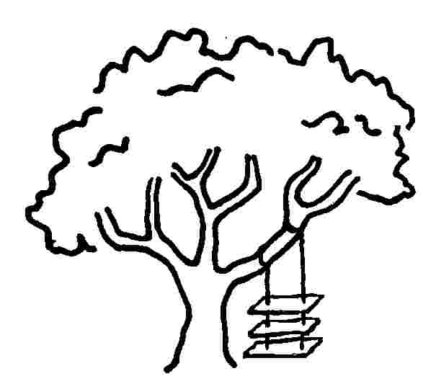



Why Prototyping Matters ?
what marketing suggested…
what was manufactured…
as maintenance installed it…
what the customer wanted…
Validation of the design hypothesis

Slide 26
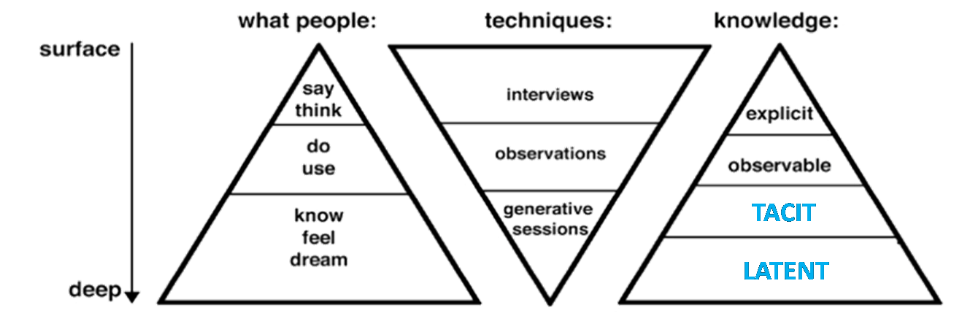
Improve acceptability / appropriation
Why Prototyping Matters ?
Niveaux des données d’usage collectées
Source : (Sleeswijk Visser et al., 2005)
Validation of the research need
User experience confrontation

Slide 27
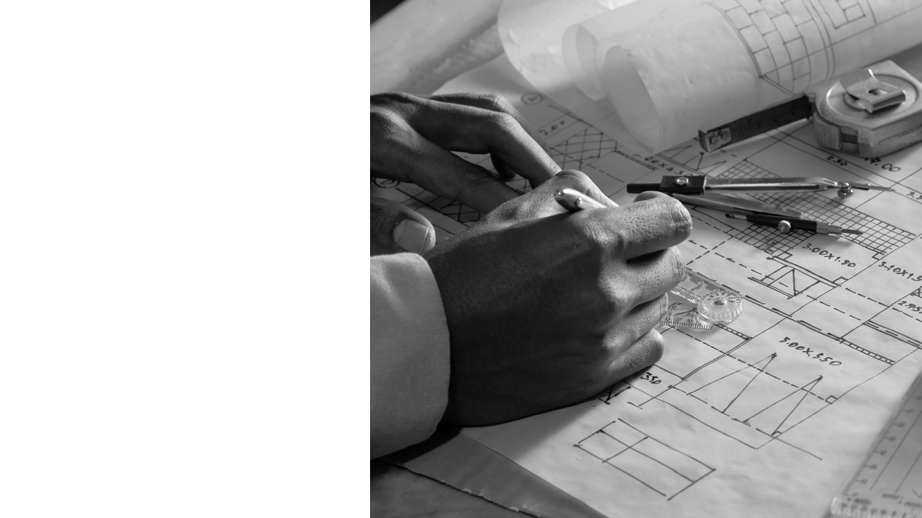
Summarizing
IDO – Intermediary design object s enables:
Shared language between stakeholders
Level of detail.
Give feedback ASAP
Improve acceptability / appropriation

Slide 28
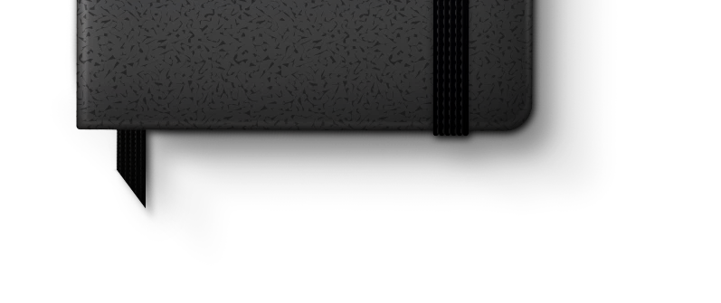
1
2
3
4
Why prototyping matters?
How to do it?
Prototyping your Idea !
Conclusion of the Day
Agenda

Slide 29


Prototyping
Real
Virtual
Products
Human scale
Cities
Immersive
Cities scale.

Slide 30
Prototyping
AESTHETICS
v
Digital Prototypes
v
Physical Prototypes
FUNCTIONALITY
Notes:
‹#›

Slide 31
Digital Prototyping
AESTHETICS
Digital
Prototype
Click-able
Comp
Simulation
Paper
Prototype
(Comp)
Archetype
Screen
(Comp)
Click-able
Wireframe
Paper
Prototype
(Wireframe)
Archetype
Screen
(Wireframe)
Sketching
v
Digital Prototypes
FUNCTIONALITY
Notes:
‹#›

Slide 32
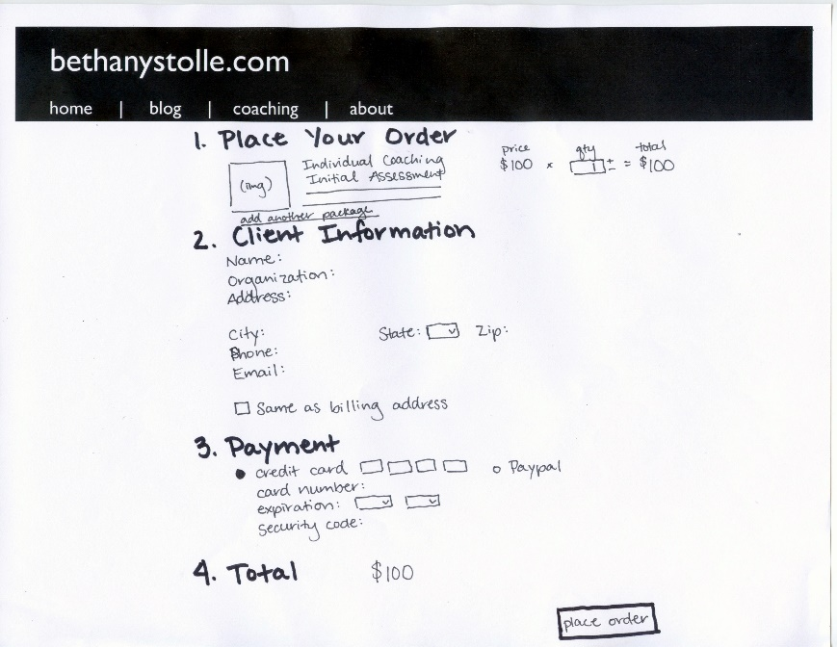
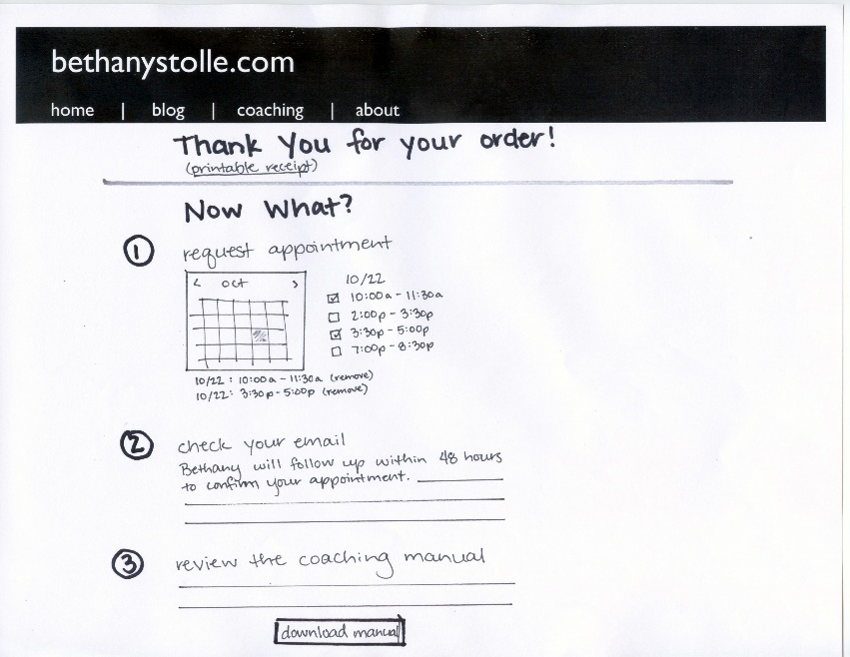
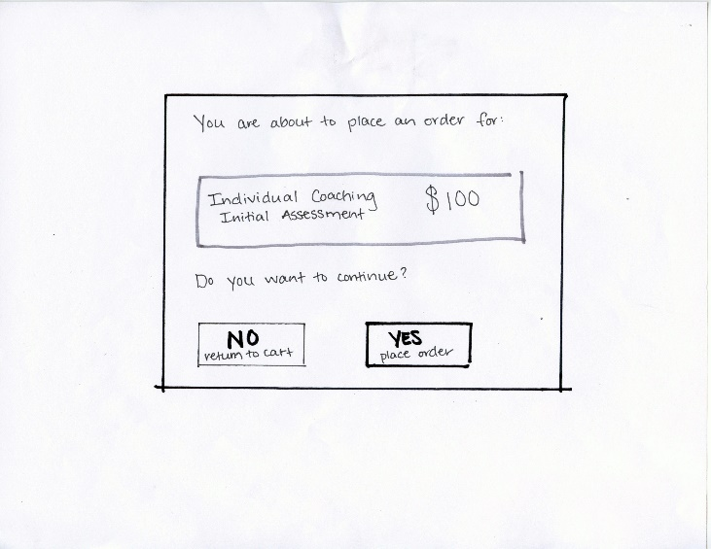
Digital Prototyping
v
Sketches
Checkout Flow | BethanyStolle
v
v
Notes:
‹#›

Slide 33
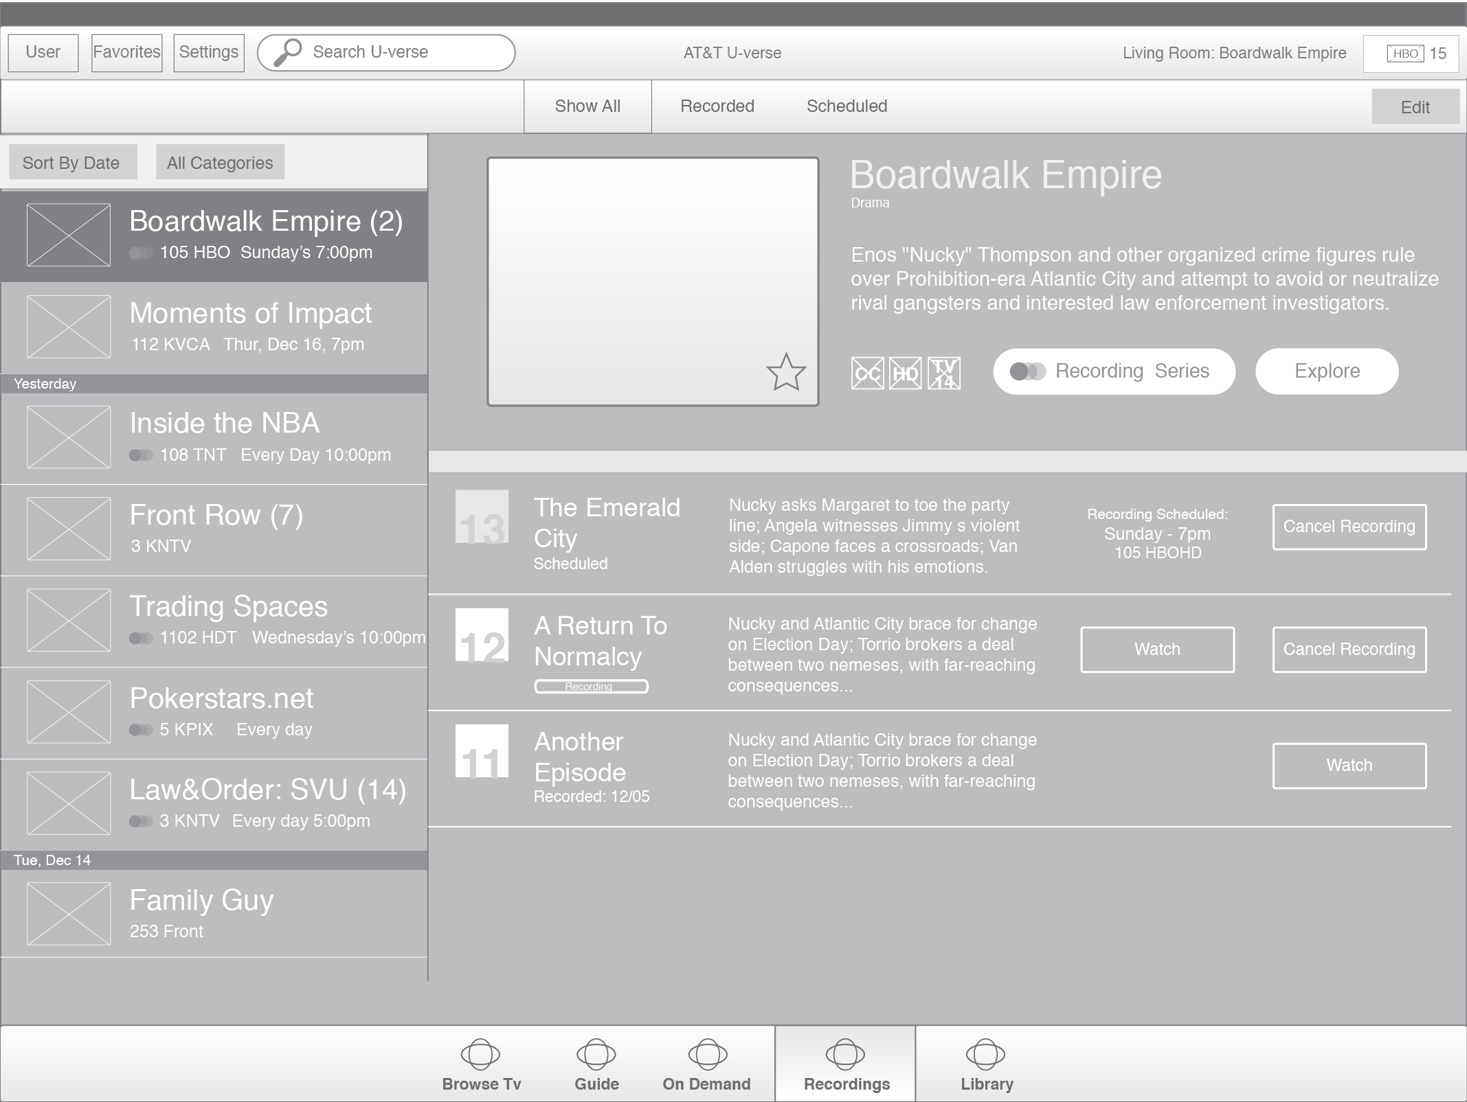
Digital Prototyping
v
Wireframe
AT&T | U-verse for Tablet
Notes:
‹#›

Slide 34
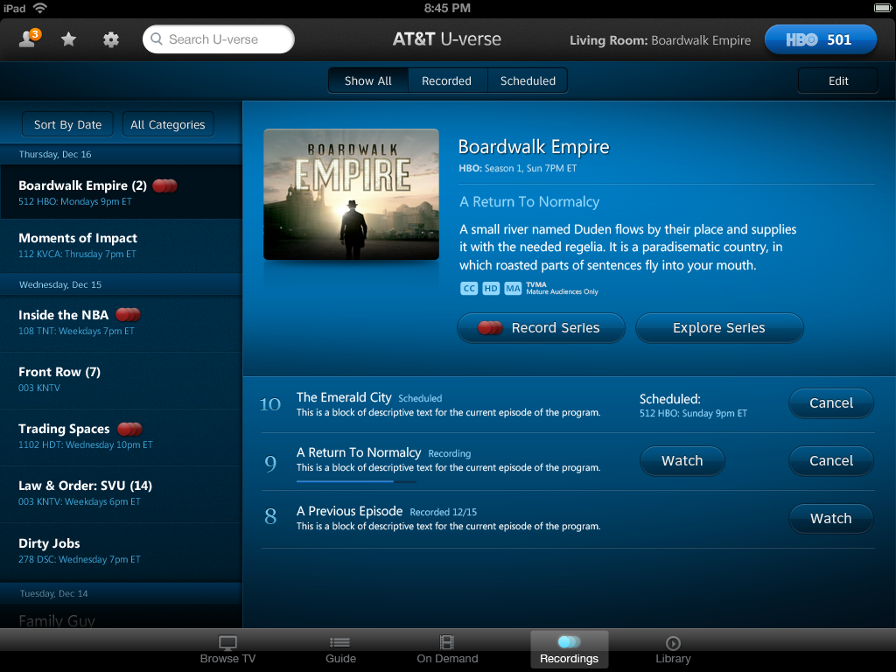
Digital Prototyping
v
Comp
AT&T | U-verse for Tablet
Notes:
‹#›

Slide 35
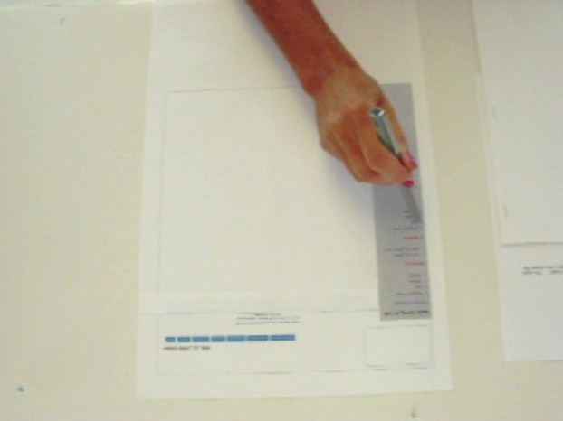
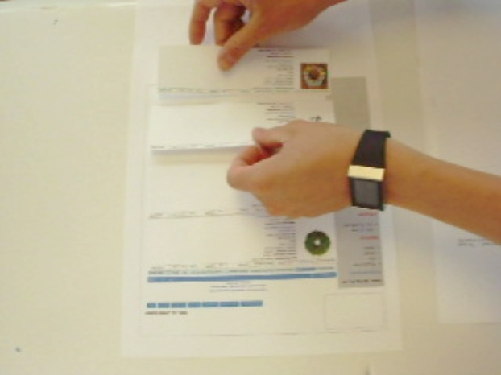
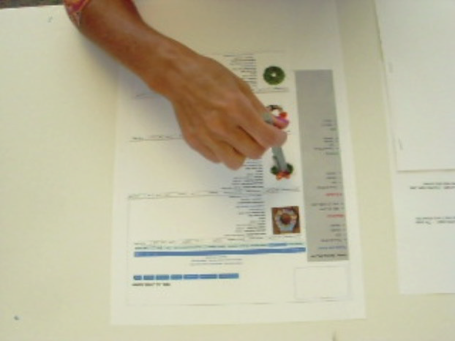
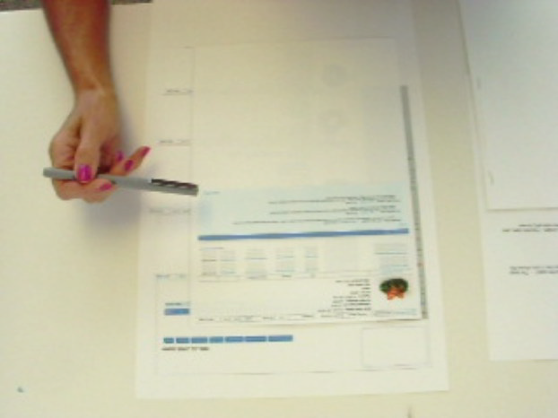
Digital Prototyping
v
Paper Prototyping
Task: Access the product details of product #1431 and confirm the vendor’s material selection.
Target | Internal PLM
Step 1
User is on the Dept home page
User “clicks” product category
Step 2
Product category is displayed
Step 3
User “clicks” a product to see the product details page
Step 4
The product details page is displayed. The user confirms the vendor’s material selection.
Notes:
‹#›

Slide 36
Digital Prototyping
AESTHETICS
Digital
Prototype
Click-able
Comp
Simulation
Paper
Prototype
(Comp)
Archetype
Screen
(Comp)
Click-able
Wireframe
Paper
Prototype
(Wireframe)
Archetype
Screen
(Wireframe)
Low Fidelity Prototypes:
Allow for rapid iteration & “on the fly” customization
Sketching
v
Digital Prototypes
FUNCTIONALITY
Notes:
‹#›

Slide 37
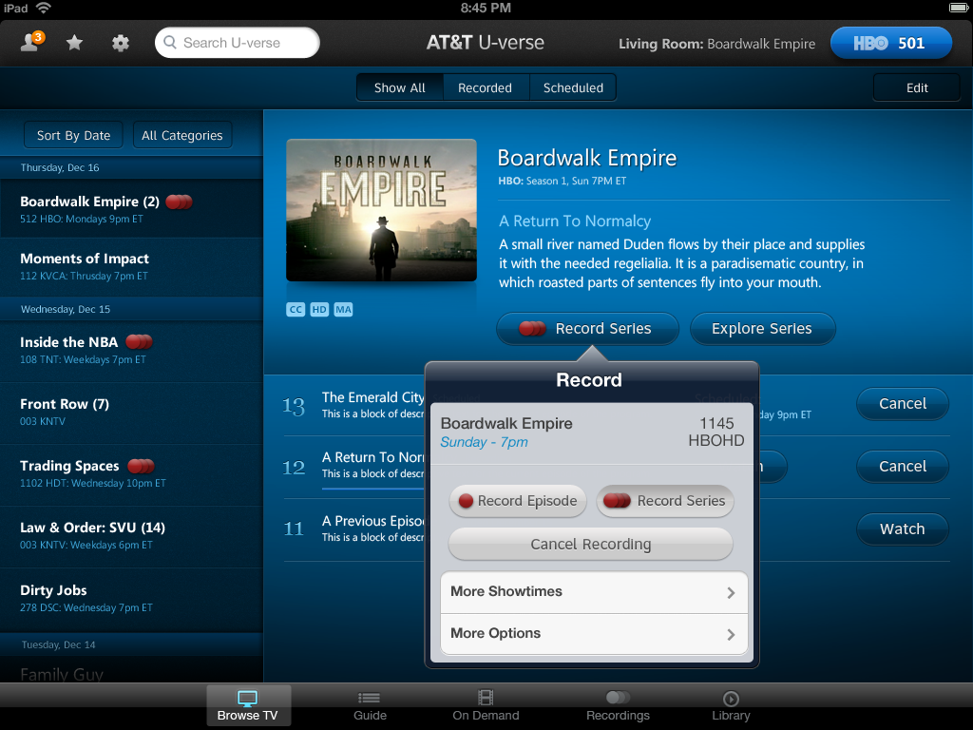
Digital Prototyping
v
Click-able Comp
Notes:
‹#›

Slide 38
Digital Prototyping
v
Click-able Comp
Notes:
‹#›

Slide 39
Digital Prototyping
AESTHETICS
Digital
Prototype
Click-able
Comp
Simulation
Paper
Prototype
(Comp)
Archetype
Screen
(Comp)
Click-able
Wireframe
Paper
Prototype
(Wireframe)
Archetype
Screen
(Wireframe)
Medium Fidelity Prototypes:
Allow for rich interactive experiences without the overhead of production code.
Sketching
v
Digital Prototypes
FUNCTIONALITY
Notes:
‹#›

Slide 40
Digital Prototyping
AESTHETICS
Digital
Prototype
Click-able
Comp
Simulation
Paper
Prototype
(Comp)
Archetype
Screen
(Comp)
Click-able
Wireframe
Paper
Prototype
(Wireframe)
Archetype
Screen
(Wireframe)
Higher Fidelity = Decreased speed of Iteration
Sketching
v
Digital Prototypes
FUNCTIONALITY
Notes:
‹#›

Slide 41
Physical Prototyping

Slide 42
Physical Prototyping
AESTHETICS
Aesthetic
Model
High Fidelity
Functional
Prototype
Form
Model
Functional
Mockup
Ergonomic
Model
Functional
Proof of Concept
Sketching
v
Physical Prototypes
FUNCTIONALITY
Notes:
‹#›

Slide 43
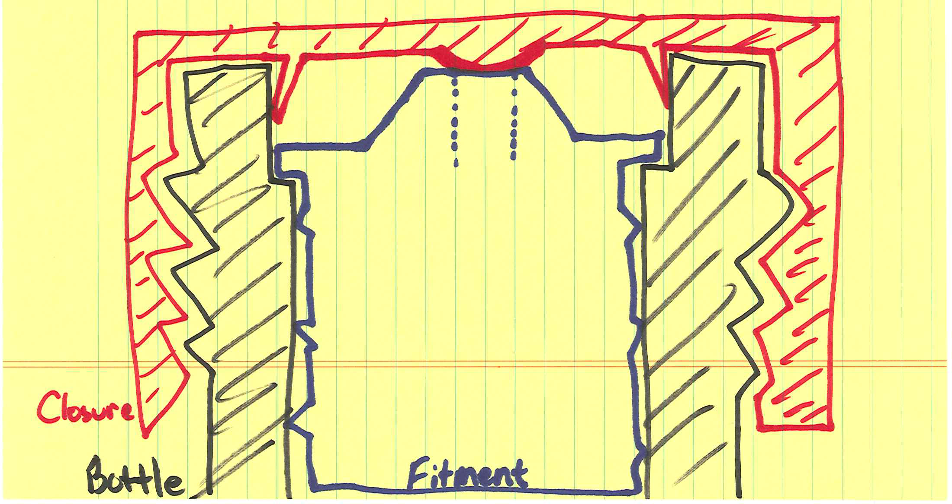
Physical Prototypes
v
Engineering Sketches
Notes:
‹#›

Slide 44

Physical Prototypes
v
Function Sketches
Notes:
‹#›

Slide 45


Physical Prototyping
v
Form Sketches
Notes:
‹#›

Slide 46

Physical Prototypes
v
Form / Ergonomic Model
Foam, paper & staples | LiLeger Inc.
Notes:
‹#›

Slide 47

Physical Prototypes
v
Ergonomic Model
Otolaryngology Tool : IDEO
Chip clip, film canister, expo marker | IDEO
Notes:
‹#›

Slide 48

Physical Prototypes
v
Form Model
Foam core & Masking Tape | SCAD
Notes:
‹#›

Slide 49

Physical Prototypes
v
Aesthetic Model
Romo – Personal Robot | Romotive
Notes:
‹#›

Slide 50
Physical Prototyping
AESTHETICS
Aesthetic
Model
High Fidelity
Functional
Prototype
Low Fidelity Prototypes:
Allow for rapid iteration
& “on the fly” customization
Form
Model
Functional
Mockup
Ergonomic
Model
Functional
Proof of Concept
Sketching
Physical Prototypes
FUNCTIONALITY
v
Physical Prototypes
Notes:
‹#›

Slide 51
Physical Prototyping
AESTHETICS
Aesthetic
Model
High Fidelity
Functional
Prototype
Medium Fidelity Prototypes:
Allow for rich interactive experiences without the overhead of manufacturing
Form
Model
Functional
Mockup
Ergonomic
Model
Functional
Proof of Concept
Sketching
Physical Prototypes
FUNCTIONALITY
v
Physical Prototypes
Notes:
‹#›

Slide 52
Physical Prototyping
AESTHETICS
Aesthetic
Model
High Fidelity
Functional
Prototype
Form
Model
Functional
Mockup
Higher Fidelity = Decreased speed of Iteration
Ergonomic
Model
Functional
Proof of Concept
Sketching
Physical Prototypes
FUNCTIONALITY
v
Physical Prototypes
Notes:
‹#›

Slide 53
What is the appropriate level of fidelity?
The level of fidelity that allows you to test what’s important while maximizing the number of possible iterations.
With most prototypes, the level of fidelity can be relatively low. People are naturally good at using their imagination to fill in the details.
Notes:
‹#›

Slide 54
Start with Low Fidelity Prototypes
These prototypes are extremely useful as they can be made quickly, changed without repercussions, and often elicit better feedback (users are not worried about hurting the designers’ feelings).
Notes:
‹#›

Slide 55





How to Make Almost Anything..
Traditional Process
Disruptive Process
Subtractive
Shaping
Additive
Economies of scale
Time to Market

Slide 56




Additive Manufacturing
A process of joining materials to make objects from 3D model data, usually layer upon layer, as opposed to subtractive manufacturing methodologies (ASTM,2012)
Fabrication layer by layer
From rapid prototyping to Direct Digital Manufacturing (Form, Fit and Function)
Digital design and manufacturing
High flexibility in geometry
Instantaneous diffusion of models at a global scale
Optimization of raw material.

Slide 57









1
2
3
How to print?
Sketchs
CAD Model
Conversion to STL format
4
5
6
Machine Setup (Gcode)
3D printing
Post-processing
Notes:
Tool chain of AM CAD STL convert
The AM Process

Slide 58



Open Source Additive Manufacturing
-RepRap Project-
FDM patent expired in 2005
Replicating Rapid-prototyper freely Available for the benefit of everyone
Open source approach . (available Information)
Global community / Global knowledge, local needs.
Low cost (<$5000)
Quality? Repeatability? …
Exponential growth
Sales of personal printers
Ford, (2014). Additive Manufacturing Technology: Potential Implication for U.S. Manufacturing. Journal of International Commerce and Economics (USA), (September), pp.1–35.
Notes:
Main idea: RepRap Projet

Slide 59












Aerospace
Automotive
Biomedical
Architechtural
Guo, N., & Leu, M. C. (2013). Additive manufacturing: technology, applications and research needs. Frontiers of Mechanical Engineering, 8(3), 215–243.
Guo, N., & Leu, M. C. (2013). Additive manufacturing: technology, applications and research needs. Frontiers of Mechanical Engineering, 8(3), 215–243.
Melchels, F. P. W., Domingos, M. a. N., Klein, T. J., Malda, J., Bartolo, P. J., & Hutmacher, D. W. (2012). Additive manufacturing of tissues and organs. Progress in Polymer Science, 37(8), 1079–1104.
Columbano, A., & Dring, M. (2010). The pedagogy of using a RP architectural model. Virtual and Physical Prototyping, 5(4), 195–200.
What can we do with AM?
Kostakis, V., Niaros, V., & Giotitsas, C. (2014). Open source 3D printing as a means of learning: An educational experiment in two high schools in Greece. Telematics and Informatics, 1–11.
Thomas, D. J., Azmi, M. a. B. M., & Tehrani, Z. (2014). 3D additive manufacture of oral and maxillofacial surgical models for preoperative planning. The International Journal of Advanced Manufacturing Technology.
http://www.core77.com/posts/24243/digital-fabrication-and-fashion-intersect-at-paris-fashion-week-24243
Education
Dentristy
Arts
Fashion
Others
Notes:
Applications of 3D printing and Open Source 3D printing

Slide 60










Future of AM
Appropiation of technology
Manufacturing / Recycling at home
3DP impact in education, childhood and family life.
Bussiness models and Intellectual Property (IP)
Development of 3DP retailers
corporatized free market (High competition)
Peer producers in the design process, (Individual expression)
Localized Manufacture
Desktop factories at home
Community crafts
Only prototyping
Co-production and collaboration in places of low corporate influence (libraries, museums, galleries)
The role of mediators and middle-people is paramount
3DP as a tmeans for Social experimentation / Interaction
Low engagement on the individual level the reliability and intuitiveness of the technology plays just as an important role in its adoption as the products it might enable.
Importance of Society’s confidence in the technology (“black swans”)
(Birtchnell and Urry , 2013)
Notes:
Tendency of the 3D printing Prospective of 3D printing with 4 scenarios
Ejemplo de Je suis charlie con 3DP black swan
4 Scenarios possibles
Reference: 3D, SF and the future (2013)

Slide 61



What is a fab lab?
Fab labs are a global network of local labs, enabling invention by providing access to tools for digital fabrication
What’s in a fab lab?
Fab labs are a global network of local labs, enabling invention by providing access to tools for digital fabrication
What does the fab lab network provide?
Operational, educational, technical, financial, and logistical assistance beyond what’s available within one lab
Who owns fab lab inventions?
Who can use a fab lab?
Designs and processes developed in fab labs can be protected and sold however an inventor chooses, but should remain available for individuals to use and learn from
Fab labs are available as a community resource, offering open access for individuals as well as scheduled access for programs
How can businesses use a fab lab?
What are your responsibilities?
Commercial activities can be prototyped and incubated in a fab lab, but they must not conflict with other uses, they should grow beyond rather than within the lab, and they are expected to benefit the inventors, labs, and networks that contribute to their success
Safety: not hurting people or machines Operations: assisting with cleaning, maintaining, and improving the lab
Knowledge: contributing to documentation and instruction

Slide 62



2D Technologies
Concept
Draw
Object
Support
How to?
“ Vectorize draw to laser cut ”

Slide 63









2D/3D Technologies
Concept
3D Model
Laser Object
Support
How to?
Fusion 360
“ Laser cut a 3D object for laser cut ”

Slide 64




2D/3D Technologies
Concept
Laser Object
Parametric 3D Models (Box)
Support
How to?
http://www.makercase.com/
http://jeromeleary.com/laser/
“ Laser-cut box generators”

Slide 65

2D/3D Technologies
Concept
Parametric 3D Models (Joins)
Laser Object
Support
How to?
Joinery
“Joints for laser cut assemblies”

Slide 66


2D/3D Technologies
Concept
Parametric 3D Models (Gears)
Laser Object
Support
How to?
http://www.geargenerator.com/
http://woodgears.ca/
“ Gear generator for laser ”

Slide 67







Concept
Create 3D Model
Printing
Support
How to?
Any 3D Software:
SolidWorks
SkechUp
Onshape
…
3D Technologies

Slide 68





Concept
Download 3D Model
Printing
Support
How to?
https://www.thingiverse.com/
https://www.instructables.com/
“ Search for whatever you want”
3D Technologies

Slide 69





Concept
Scanner 3D Model
Printing
Support
How to?
Sense Scanner
3D Technologies

Slide 70



Concept
Hologram object
Support
How to?
https://holusion.com
3D/4D Technologies

Slide 71


Concept
Table Tactile
Support
How to?
https://www.intuilab.com/
3D/4D Technologies

Slide 72

Concept
Immersive Environment
Support
How to?
3D/4D Technologies

Slide 73






Concept
Virtual Reality Environment
Support
How to?
Unity
3D/4D Technologies
Unreal

Slide 74
1
2
3
4
Why prototyping matters? .
How to do it?
Prototyping your Idea !
Conclusion of the Day
Agenda

Slide 75

Plan

Slide 76

Prototyping your Idea
Goal:
Morning:
Have an Intermediary design object
Afternoon
To test with users

Slide 77
In resume,
What Technologies?
2D
3D
3D/4D

Slide 78

Now,
It’s your turn for Do-It-Yourself…

Slide 79







Dormant Patents Workshop
Materialization
July, 11 2023
ENSGSI / UL - Nancy

Slide 80

Brand new facilities Nancy thermal has been inaugurated in 2023 after several years of renewal
We must find original uses for Nancy thermal water by exploring available scientific resources (patents, scientific journals…)
Having in mind the goal of the city for seeking a virtuous synergy between well-being and eco-responsiveness

Slide 81






Prototyping your Ideas

Slide 82
Teams
Walid BOUZID
Rohith RAVI
Fatima Ezzarha BELKHENFAR
Zakia MOHSIN
Nathan LINTINGRE
1
Fatima Zahra ATLANE
Israel Iaac ZETINA
Said BOUCHOUKOU
Chaima IDRISSI
2
Viktor MANDROLKO
Oumaima ZOUHRI
Mohamed BALHOUS
Sevra CICEKLI
3
Jaloud Ibrahim MAIGA
Khadija EL IDRISSI
Houssam ELFENNACI
Lisa DE MEYER
4
Marta CANTINA
Alain UWADUKUNZE
Youness EL GHAZOUANI
Faratiana Herline MINOARISOA
5
Masuhiul HUQ
Marie-Amélie RATTE
Isibert NKENFACK
Maryam HAMSAN
Huiyuan Kelvin HAN
6

Slide 83
1
2
3
4
Why prototyping matters? .
How to do it?
Prototyping your Idea !
Conclusion of the Day
Agenda

Slide 84
Complementary dynamics and technologies
Accelerate demostratror’s deployment for
Companies
Sectors
Cities and territories

Slide 85

Conclusions
The more IDO (Intermediary design object), the better the final product
Different IDO’s: Conceptual, Form Functional.
Prototyping matters!!
IDO are evolutionary. Each IDO enables to find new questions in the design process.
Real or Virtual prototype gives a common language.
Open Source technology are a great support to start an IDO.

Slide 86



Summer School
« Thank you»
Prototyping your Idea
PhD. Fabio CRUZ - ERPI / LF2L
fabio-alberto.cruz-sanchez@univ-lorraine.fr

